Slide 1
Cognitive models

Slide 2
Cognitive models
Simulating human problem-solving and mental processing in a computerized model. Such a model can be used to simulate or predict human behavior or performance on tasks similar to the ones modeled and improve human-computer interaction.

Slide 3
Cognitive models
They model aspects of user:
understanding
knowledge
intentions
processing

Slide 4
Cognitive models
Goal and task hierarchies
GOMS
CCT
Linguistic
BNF
TAG

Slide 5
Goal and Task Hierarchy Model
Many models make use of the model of mental processing, in which user achieves goal by solving sub goals in divide and conquer fashion
Two such models are GOMS, CCT.

Slide 6
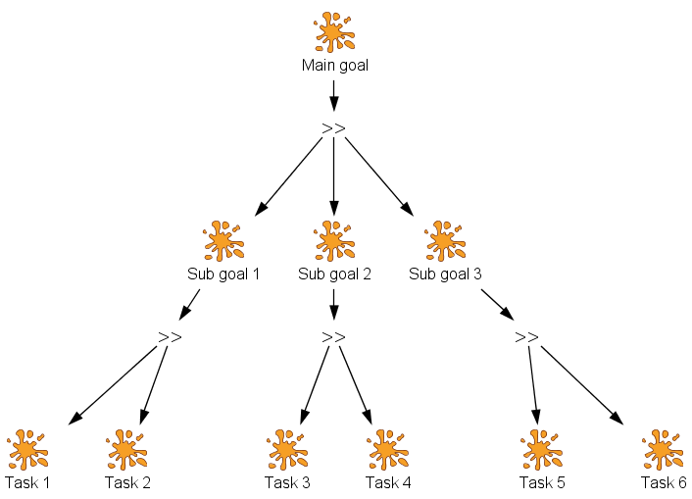
Goal and Task Hierarchy Model

Slide 7
GOMS
It Consist of these four elements
Goals: User goals, describing what user want to achieve
Operators: what basic action can be performed
Methods: what sequences of operators can be used to accomplish a goal.
Selection: which methods should be used to accomplish goal.

Slide 8
GOMS
Example:
Photocopying an article from a journal
GOAL: PHOTOCOPY-PAPER
GOAL: LOCATE-ARTICLE
GOAL: PHOTOCOPY-PAGE repeat until no more pages
GOAL: ORIENT-PAGE
OPEN-COVER
SELECT-PAGE
POSITION-PAGE
CLOSE-COVER
GOAL: PRESS-COPY-BUTTON
GOAL: VERIFY-COPY
LOCATE-OUT-TRAY
EXAMINE-COPY
GOAL: COLLECT-COPY
LOCATE-OUT-TRAY
REMOVE-COPY (outer goal satisfied!)
GOAL: RETRIEVE-JOURNAL
OPEN-COVER
REMOVE-JOURNAL
CLOSE-COVER

Slide 9
Disadvantages of using GOMS
Only works for goal-directed task
Assumes tasks performed by experts without error
Does not address several UI issues,
-readability, memorizability of icons, commands

Slide 10
Cognitive Complexity Theory
Basic premises of goal decomposition
Provides more productive power
It provides two parallel descriptions
User - production rules of the form:
if conditions then action
Device – generalized transition networks
cover under dialogue models

Slide 11
Cognitive Complexity Theory
Users with high cognitive complexity are open to new information, attracted to other individuals of high complexity, highly flexibility, socially influential, problem solvers, strategic planners, highly creative, effective communicators and generally good leaders.

Slide 12
Problems with goal hierarchies
Description can be enormous
Post hoc technique: risk is that it is defined by the computer dialog and not user
Simple extensions possible
goal closure (makes sure sub goal satisfied)
example. ATM

Slide 13
Linguistic Model
User’s interaction with computer is often viewed in terms of language
Understanding the user's behaviour and cognitive difficulty based on analysis of language between user and system.
Similar in emphasis to dialogue models
Backus–Naur Form (BNF)
Task–Action Grammar (TAG)

Slide 14
BNF
Backus-Naur Form(BNF) rules to describe the dialog grammar
This views the dialog at a purely syntactic level, ignoring the semantics of language
BNF has been used widely to specify the syntax of computer programming languages

Slide 15
BNF
For example, imagine a graphics system that has line-drawing function
draw-line ::= select-line + choose-points+ last-point
select-line ::= position-mouse + CLICK-MOUSE
choose-points ::= choose-one |
choose-one + choose-points
choose-one ::= position-mouse + CLICK-MOUSE
last-point ::= position-mouse + DOUBLE- CLICK-MOUSE
position-mouse ::= null | MOVE-MOUSE + position-mouse

Slide 16
BNF Example
US postal address
<postal address > ::= <name-part> <street-address> <zip- part>
<name-part> ::= <personal-part> <last-name> [<jr- part>] <EOL> | <personal-part> <name-part>
<personal-part> ::= <name> | <initial> “.”
<street-address> ::=[<apt>] <house-num> <street-name> <EOL>
<zip-part> ::= <town-name> “.” <state-code> <ZIP- code> <EOL>

Slide 17
complications
Same syntax for different semantics
No reflection of user’s perception
Minimal consistency checking

Slide 18
Task Action Grammar(TAG)
Making consistency more explicit
Encoding user's world knowledge
Parameterised grammar rules
Nonterminals are modified to include additional semantic features

Slide 19
Consistency in TAG
In BNF, three UNIX commands would be described as:
copy ::= cp + filename + filename | cp + filenames + directory
move ::= mv + filename + filename | mv + filenames + directory
link ::= ln + filename + filename | ln + filenames + directory
No BNF measure could distinguish between this and a less consistent grammar in which
link ::= ln + filename + filename | ln + directory + filenames

Slide 20
Consistency in TAG
consistency of argument order made explicit using a parameter, or semantic feature for file operations
Feature Possible values
Op = copy; move; link
Rules
file-op[Op] ::= command[Op] + filename + filename
| command[Op] + filenames + directory
command[Op = copy] ::= cp
command[Op = move] ::= mv
command[Op = link] ::= ln

Slide 21
THANK YOU

